Slide 1
The Nephilim
Myth or inconvenient truth?

Slide 2
Genesis 6:1-4
6 When human beings began to increase in number on the earth and daughters were born to them, ² the sons of God saw that the daughters of humans were beautiful, and they married any of them they chose. ³ Then the Lord said, “My Spirit will not contend with^{[a]} humans forever, for they are mortal^{[b]}; their days will be a hundred and twenty years.”
⁴ The Nephilim were on the earth in those days—and also afterward—when the sons of God went to the daughters of humans and had children by them. They were the heroes of old, men of renown.

Slide 3
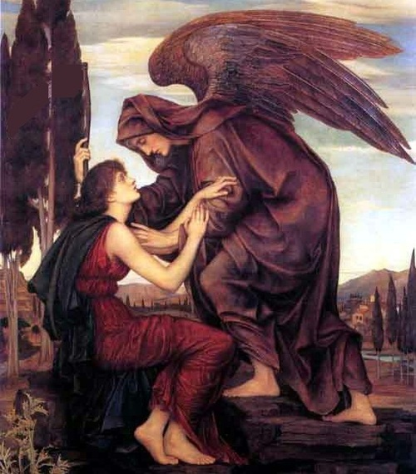
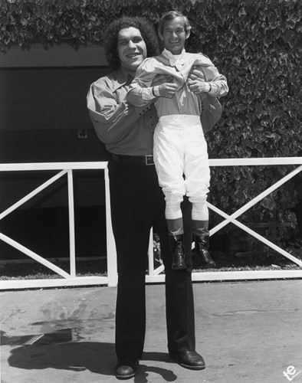
Mythology
Sons of God = Angelic beings
Daughters of Men = Human Women
Nephilim = Giants
God’s anger – flood.

Slide 4
Untangling the text 1:
⁴ The Nephilim were on the earth in those days—and also afterward—when the sons of God went to the daughters of humans and had children by them. They were the heroes of old, men of renown.
⁴That was when Manchester City football club first began to make multimillion pound transfers – when John Major was prime-minister. They were the cup winners that year, a tremendous achievement.

Slide 5
Untangling the text 2:
⁴ The Nephilim were on the earth in those days—and also afterward—when the sons of God went to the daughters of humans and had children by them. They were the heroes of old, men of renown.
⁴ The Nephilim were on the earth in those days—and also afterward—when the sons of God went to the daughters of humans and had children by them. They were the heroes of old, men of renown.

Slide 6
Identifying the Nephilim
Numbers 13:32-33
All the people we saw there are of great size. ³³ We saw the Nephilim there (the descendants of Anak come from the Nephilim). We seemed like grasshoppers in our own eyes, and we looked the same to them.”

Slide 7
Mythology. . .
Angels ‘marry’ Human Women
Nephilim (giants) result
God is angry and destroys the earth
Nephilim on the Ark?
Where did the descendants of Anak come from?

Slide 8
Logical Explanation. . .

Slide 9
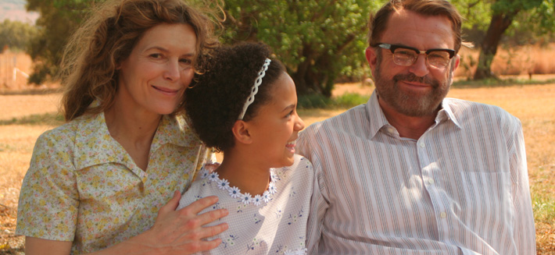
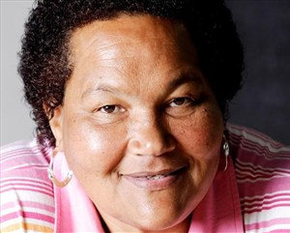
DNA Complexities
Sandra Laing – South Africa - 1955

Slide 10
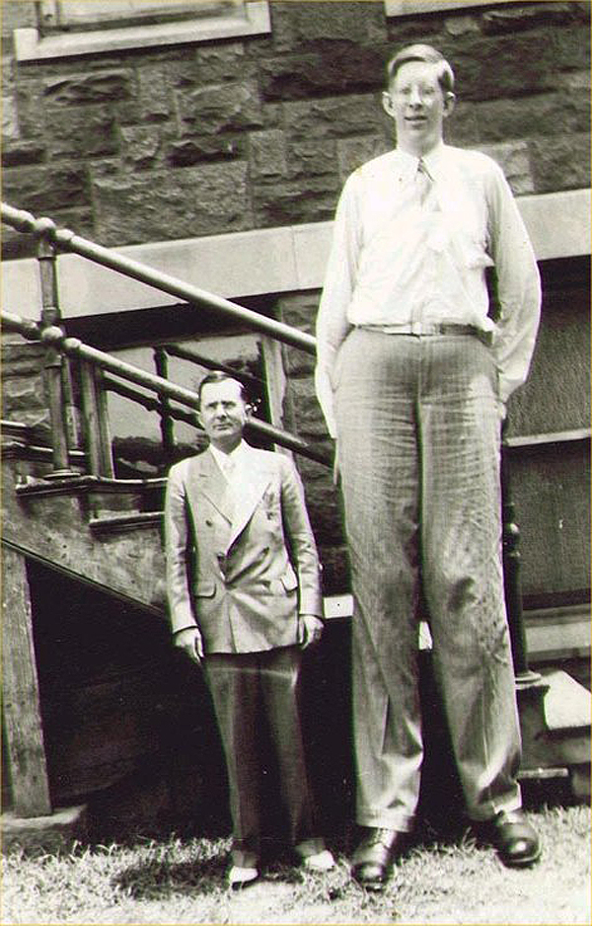
DNA Complexities . . .
Robert Wadlow – 1918 - 1940

Slide 11
Probable Explanation:
‘Giants’ – Nephilim
Simply genetic variants within the human race
Range of the human race from:
Fair hair, white skin, blue eyes
Dark hair, dark skin, brown eyes
Tall Scandinavians
Small Kalahari Bushmen
Variations tend to consolidate within populations due to environmental factors or selective reproduction.

Slide 12
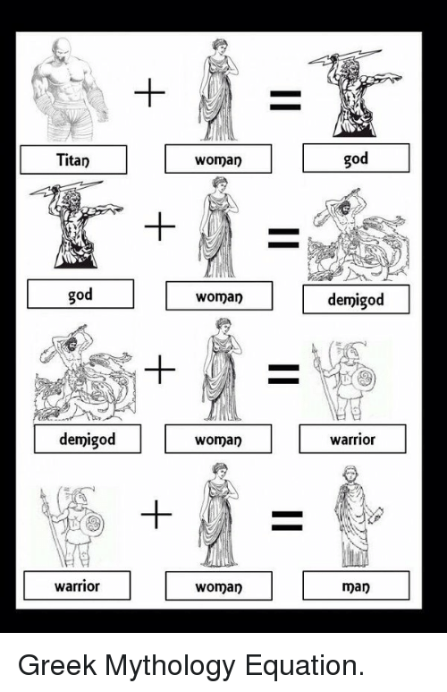
Sons of God?
Myth
Sons of God = Angels
Angel + Woman = Warrior
Nephilim = Warrior

Slide 13
Reality?
Any explanation must:
Arise from a ‘simple’ reading of the text
Be consistent with themes throughout Scripture
Be agreed by a majority of scholars (e.g. Commentaries)

Slide 14
Simple Reading of the Text - Sons of God
Luke 3:38
³⁸ the son of Enosh, the son of Seth, the son of Adam, the son of God.
John 1:12
¹² But as many as received him, to them gave he power to become the sons of God, even to them that believe on his name.
Job 38:7
When the morning stars sang together, and all the sons of God shouted for joy? (KJV - Hebrew) ( Angels - NIV)

Slide 15
Do Angels Marry?
Luke 20:34-36
³⁴ Jesus replied, “The people of this age marry and are given in marriage. ³⁵ But those who are considered worthy of taking part in the age to come and in the resurrection from the dead will neither marry nor be given in marriage, ³⁶ and they can no longer die; for they are like the angels. They are God’s children, since they are children of the resurrection.

Slide 16
Conclusion:
Adam was the first ‘son of God’
Born again Christians are ‘sons of God’
Angels cannot ‘marry’
Therefore - the sons (and daughters) of God are those who:
Have not rebelled against God
OR
Have been restored after rebellion

Slide 17
Understanding Beginning and End:
Genesis
God / Serpent (Dragon)
Sons (daughters) of God / Sons (daughters) of man
Revelation
God / Dragon (serpent)
Seal of God / Mark of the Beast

Slide 18
Consistent throughout - Separation:
Revelation 18:4
⁴ Then I heard another voice from heaven say:
“‘Come out of her, my people,’ so that you will not share in her sins, so that you will not receive any of her plagues;
Prior to the destruction of the Earth – God’s people IN Babylon
Prior to the Flood – God’s people began to mingle with ‘man’

Slide 19
Consistency - Separation
Abraham called to ‘come out’ of Ur
Israel were to be a ‘separate’ nation.
1 Peter 2:9
⁹ But you are a chosen people, a royal priesthood, a holy nation, God’s special possession, that you may declare the praises of him who called you out of darkness into his wonderful light.
Revelation 18:4
“Come out of her my people. . . “

Slide 20
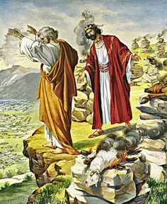
Consistency - Separation
Balaam
Numbers 25
While Israel was staying in Shittim, the men began to indulge in sexual immorality with Moabite women, ² who invited them to the sacrifices to their gods. The people ate the sacrificial meal and bowed down before these gods. ³ So Israel yoked themselves to the Baal of Peor. And the Lord’s anger burned against them.

Slide 21
Is it just about Marriage?
Genesis 24:3-4
³ I want you to swear by the Lord, the God of heaven and the God of earth, that you will not get a wife for my son from the daughters of the Canaanites, among whom I am living, ⁴ but will go to my country and my own relatives and get a wife for my son Isaac.”
Deuteronomy 7:3
³ Do not intermarry with them. Do not give your daughters to their sons or take their daughters for your sons,

Slide 22
Is it just about Marriage?
Ezra 9:12
¹² Therefore, do not give your daughters in marriage to their sons or take their daughters for your sons.
2 Corinthians 6:14
¹⁴ Do not be yoked together with unbelievers. For what do righteousness and wickedness have in common? Or what fellowship can light have with darkness?

Slide 23
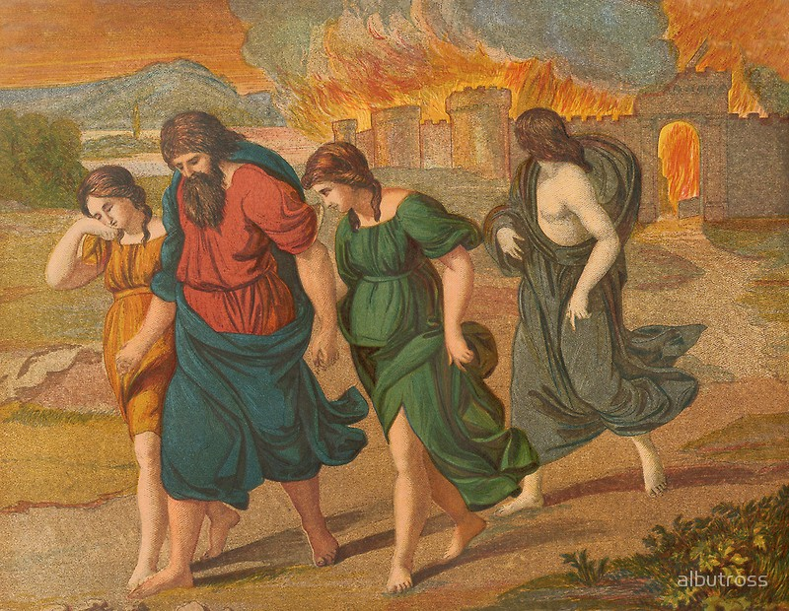
Not just about Marriage. . .
Genesis 18-19

Slide 24
Lot and Sodom
Three ‘groups’ of people respond to the call:
Sons in law – refuse to leave (comfortable where they are)
Lot’s wife – leaves but looks back (heart is still in Sodom)
Lot’s daughters – take the girl out of Sodom but not Sodom out of the girl!

Slide 25
“Come out of her my people. . .”
Where will we be when the call comes?
Which character in the story of Lot and Sodom will we most be like?
Are we prepared to ‘be separate’?
Are we in danger of doing what the ‘sons of God’ did before the flood?
What does it mean to “Come out of her my people?”
What does it mean to us personally to ‘be separate’?
*

